Slide 1


Pod C497:
Ad-Venture Time
By Jose Villa, Eilani Aguilar, Kimberly Cruz,
Scott Bond, Nancy Rosa
Notes:
Say title

Slide 2


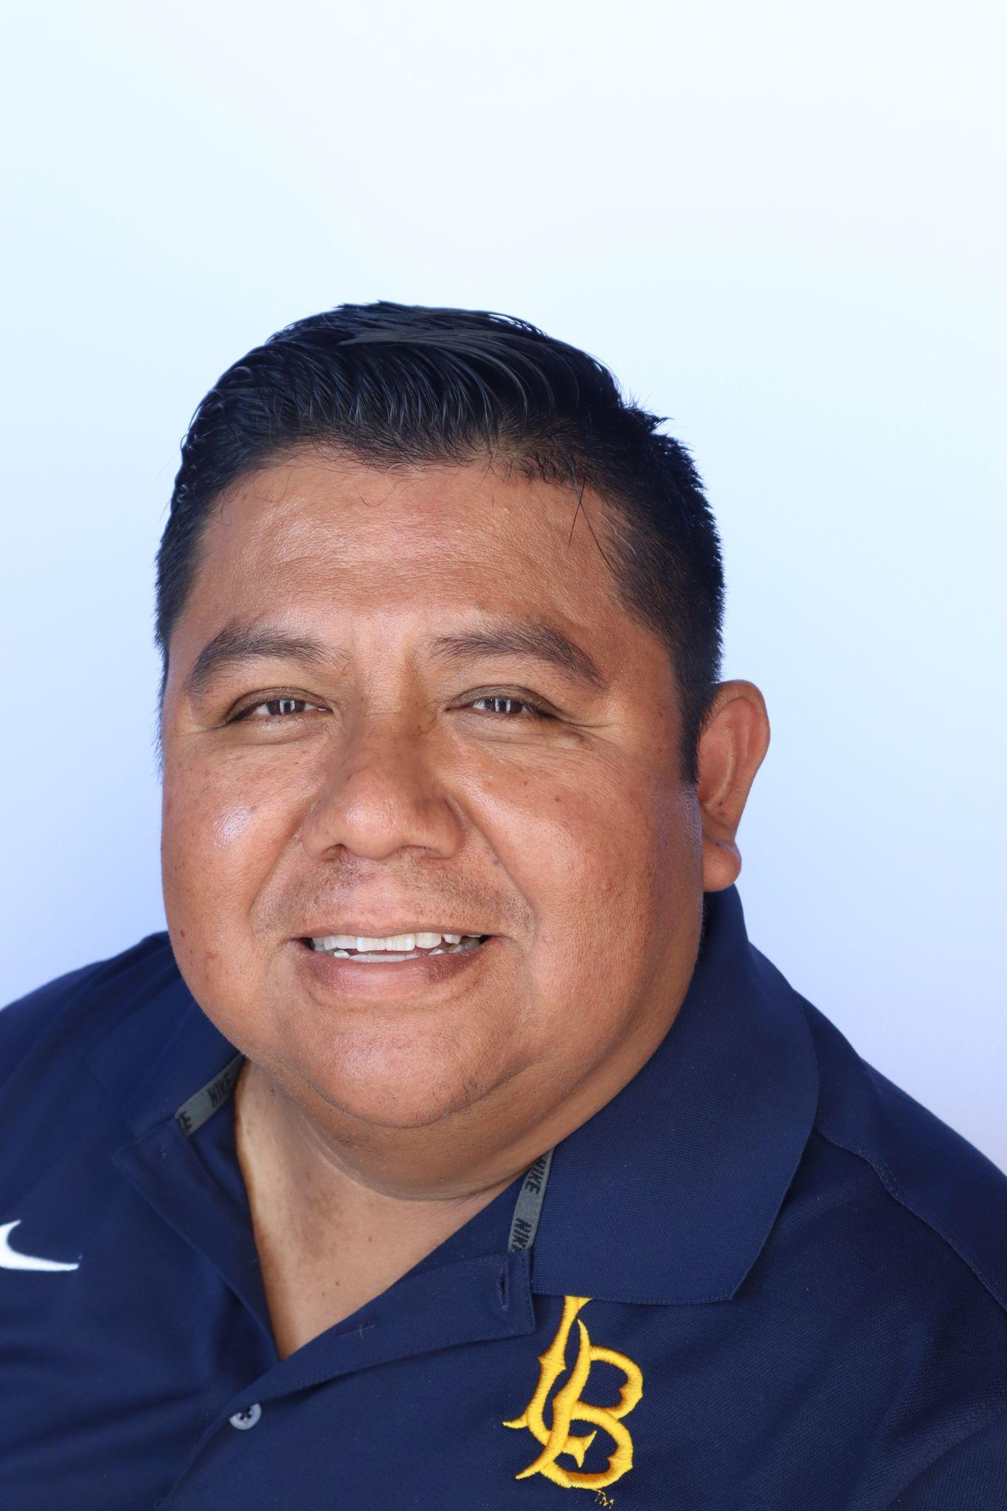
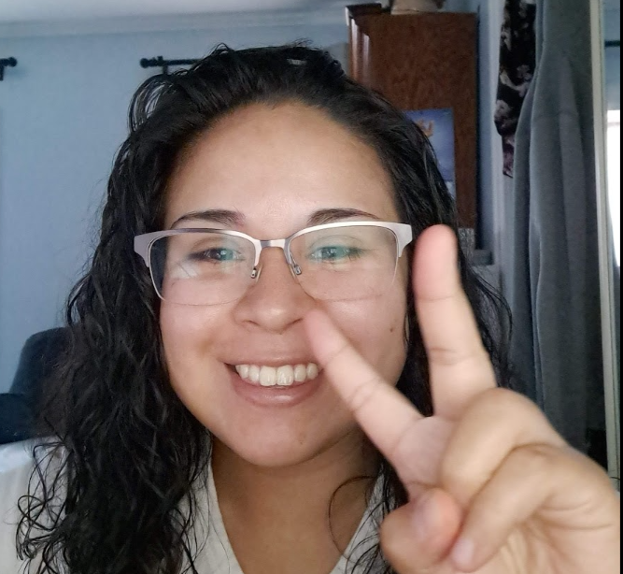

Ad-Venture Time: Meet The Team!
Pic
Pic
Pic
Pic
Pic
Kimberly Cruz
Audience Analyst
Scott Bond
Location Analyst
Nancy Rosa
Creative Analyst
Jose Villa
Eilani Aguilar
Inventory Analyst
Notes:
Introduce ourselves

Slide 3
Table of Contents
01
02
03
04
Introduction
Goals
Who we are, our client, effective campaign
Analyst Goals
Key Insight
Conclusion
Analysis based on specific areas of focus
Recommendations
Notes:
Eilani

Slide 4

Introduction
Ad-Venture Time, a leading marketing agency, has been entrusted with consolidating, analyzing, and reporting on a global organization's marketing campaign data across multiple channels.
Our goal is to deliver a comprehensive overview of the client's marketing efforts, uncovering key insights and identifying areas for improvement. By leveraging our expertise, we focus on optimizing future strategies through in-depth analysis of critical areas such as Location, Audience, Creative, and Inventory, providing actionable recommendations to drive enhanced performance.
Notes:
Nancy

Slide 5
Measuring Effectiveness
Goal Type | Primary Goal | Secondary Goal
Audience | $250 CPA | 0.015% CTR
Desktop Conversion | $350 CPA | 0.015% CTR
Smartphone Conversion | $400 CPA | 0.015% CTR
Viewability | 60% | $80 vCPM
Notes:
Nancy

Slide 6
Goals
01
02
03
04
Audience Analyst
Location Analyst
Identify the top 10 highest-performing audiences and develop three distinct personas.
Identify the most cost-effective locations and highlight the top and bottom performers
Creative Analyst
Inventory Analyst
Identify highest and lowest creative sizes. As well as creative size performance against devices, location, and ad message.
Determine which source provides the highest performance and recommend five distinct publishers to the client.
Notes:
kimb

Slide 7


Key Insights
Audiences

Slide 8
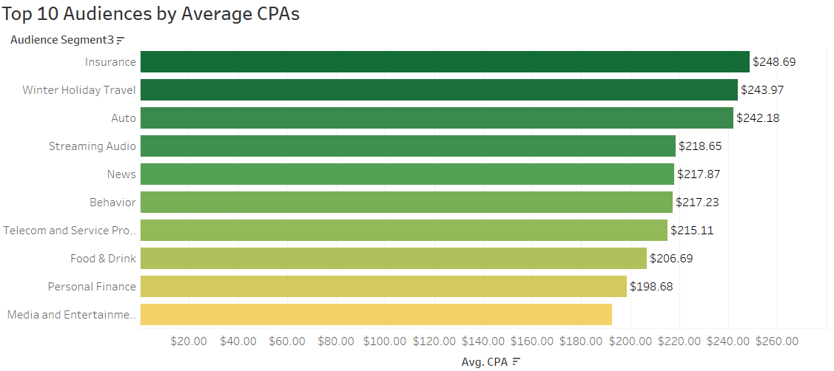

Slide 9

Persona 1: Traveler
Name: Tracy Walker
Demographics: 29 years old, female, travel blogger
Interests: Winter holiday travel, auto travel, online vehicle ownership
Hobbies: Plans and documents road trips and winter getaways, actively seeks out travel deals and vehicle maintenance tips online.
Pain Points: Managing travel costs, ensuring vehicle reliability during trips, finding new content ideas.
Goals: Explore new destinations, provide valuable travel insights to her audience, maintain a well-functioning vehicle.

Slide 10

Persona 2: Tech-savvy
Name: Tom Apple
Demographics: 35 years old, male, IT professional
Interests: Streaming audio, telecom and service providers, software
Hobbies: Continuously updates tech gadgets, subscribes to multiple streaming services, relies heavily on telecom services for work and personal use.
Pain Points: Keeping up with rapid tech advancements, managing multiple subscriptions, finding reliable telecom services.
Goals: Stay current with the latest technology, enhance personal entertainment experiences, ensure seamless connectivity.

Slide 11

Persona 3: Real-Estate
Name: Irene Fax
Demographics: 42 years old, female, financial advisor
Interests: Personal finance, news, media and entertainment
Hobbies: Regularly reads financial news, stays updated on global events, enjoys media content that informs and entertains.
Pain Points: Navigating complex financial landscapes, filtering through vast amounts of news for relevant information, balancing work and leisure.
Goals: Provide accurate financial advice, stay informed about current events, enjoy quality media content during downtime.

Slide 12
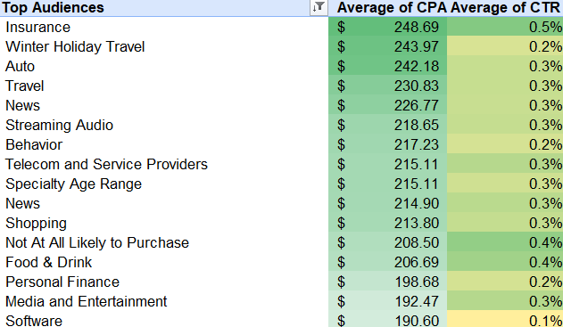
Top 10 Performing Audiences

Slide 13

Key Insights
Location

Slide 14
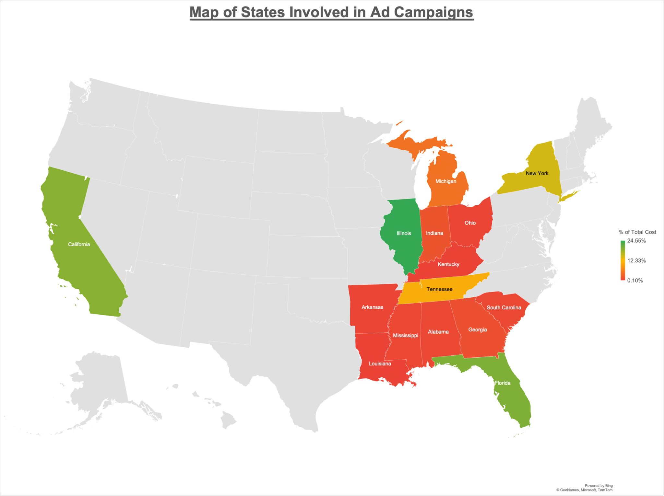
15 States involved in total Ad campaign.
Majority of Ad spend was invested in the midwest, south and east coast regions of the United States.

Slide 15
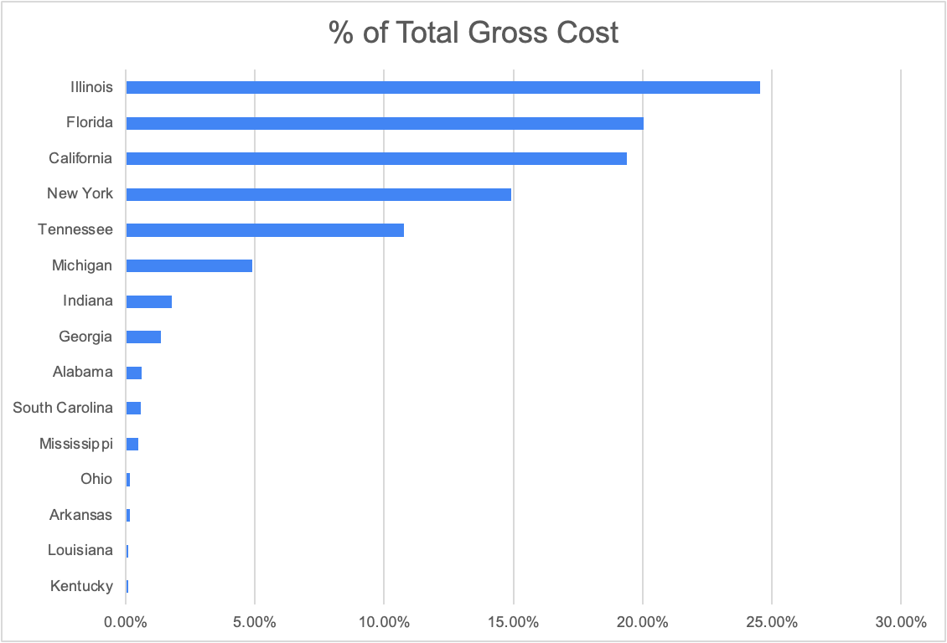
Uneven allocation of total Ad spend in relation to region and by state.
Illinois had the highest total % of gross cost at 24.55%.

Slide 16
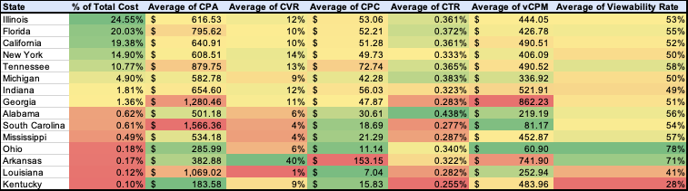
Performance Analysis by State

Slide 17
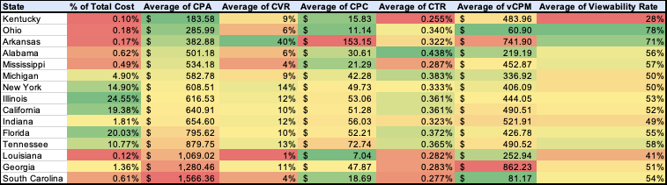
Top 3 Most Cost Effective States

Slide 18
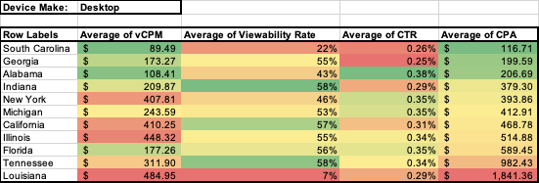
Devices’ Primary and Secondary Goal by States

Slide 19
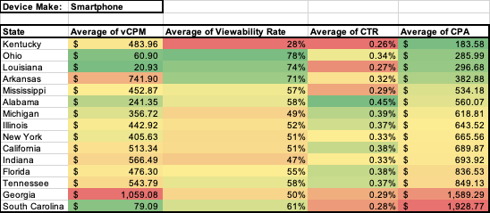
Devices’ Primary and Secondary Goal by States

Slide 20
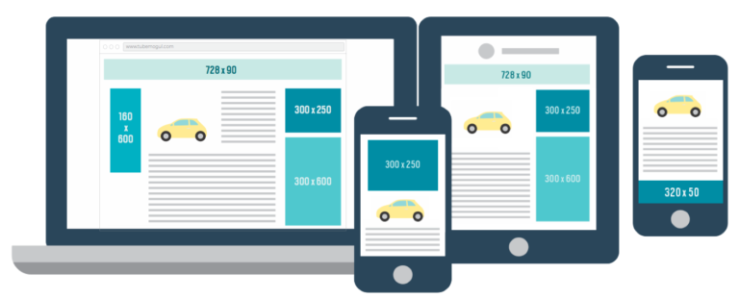
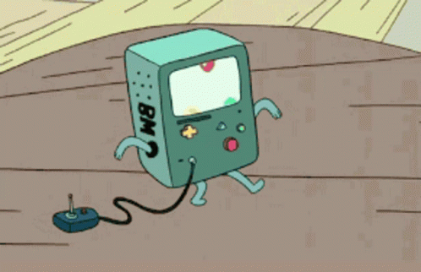

Key Insights
Creative

Slide 21


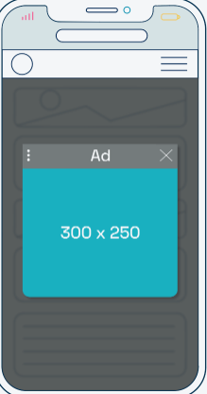

Creative Formats
Creative Size | Description | Image
Mobile Banner 300 x 50 | An ad on mobile devices One of the smallest ad sizes Does not cost much to run
Mobile Leaderboard 320 x 50 | An ad on mobile devices Does not cost much to run Top performing mobile ad unit
Medium Rectangle 300 x 250 | An ad on both Desktop on Mobile Most popular ad unit One the most expensive ad units

Slide 22
Creative Sizes: Performance
Sizes | CPA | CPC | CPM | CVR
300x250 | $322.54 | $10.81 | $30.69 | 3.35%
300x50 | $455.71 | $16.78 | $50.52 | 3.68%
320x50 | $309.09 | $11.95 | $30.66 | 3.87%

Slide 23
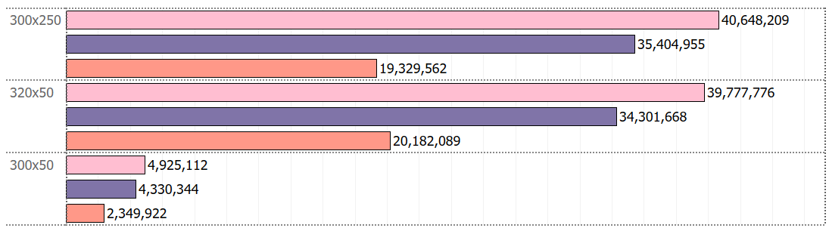
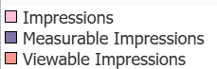
Creative Size: Performance
Creative Sizes | CTR | Viewability | vCPM
300x250 | 0.28% | 54.60% | $64.54
300x50 | 0.30% | 54.27% | $105.88
320x50 | 0.26% | 58.84% | $60.43

Slide 24
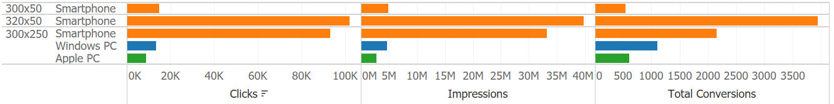
Creative Size + Device
Size | Device | CVR | vCPM | CTR | Viewability
300x250 | Apple PC | 6.78% | $173.92 | 0.32% | 49.72%
 | Smartphone | 2.31% | $45.79 | 0.28% | 55.29%
 | Windows PC | 8.29% | $143.73 | 0.29% | 52.57%
320x50 | Smartphone | 3.87% | $60.43 | 0.26% | 58.84%
300x50 | Smartphone | 3.68% | $105.88 | 0.30% | 54.27%

Slide 25
Creative Size + Location
Size | State | CPA | Vcpm | CTR | Viewability
320x50 | Ohio | $243.31 | $28.00 | 0.28% | 77.08%
 | Georgia | $419.59 | $298.58 | 0.28% | 44.31%
300x50 | Illinois | $446.67 | $39.82 | 0.31% | 58.93%
 | Michigan | $584.86 | $232.86 | 0.27% | 18.00%
300x250 | California | $375.64 | $49.53 | 0.28% | 60.48%
 | Michigan | $422.83 | $155.92 | 0.32% | 35.25%

Slide 26
Creative Size + Message
Size | Message | CPA | Vcpm | CTR | Viewability
320x50 | 10% Discount - Ends 6/1 | $252.17 | $34.65 | 0.20% | 62.49%
 | Sign up Now - 10% Off | $459.54 | $95.01 | 0.28% | 57.85%
300x50 | Sign up Now - 10% Off | $329.79 | $46.48 | 0.34% | 61.04%
 | Subscribe Today - 10% | $468.33 | $223.10 | 0.27% | 41.77%
300x250 | Sign up Today - 10% Off | $348.65 | $62.96 | 0.29% | 58.78%
 | 10% Discount - Ends 6/1 | $339.36 | $79.80 | 0.28% | 52.65%

Slide 27

Key Insights
Inventory
By
Eilani Aguilar
Jose Villa

Slide 28
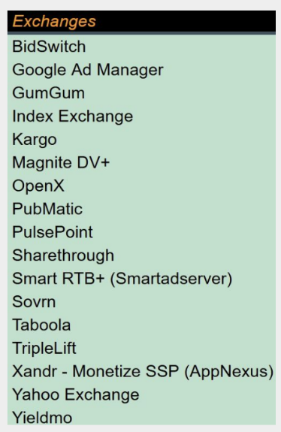
Which Exchanges were used throughout marketing efforts?
Overall, 17 Exchanges were utilized

Slide 29
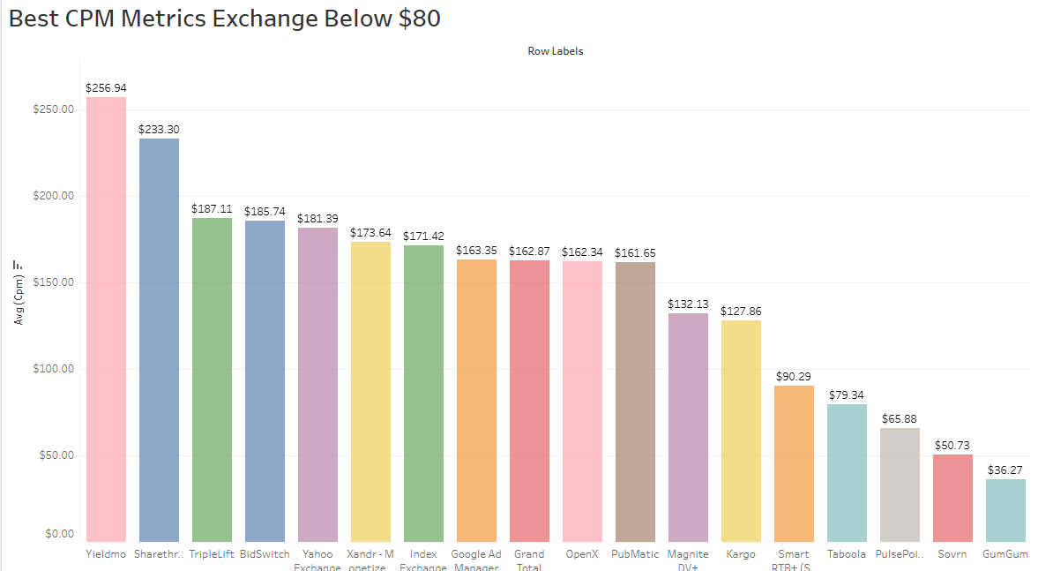
Primary Goals Achieved
These are the exchanges that have below cost of $80 per thousand impressions.
Taboola $79.34
PulsePoint $65.88
Sovrn $50.73
GumGum $36.27

Slide 30
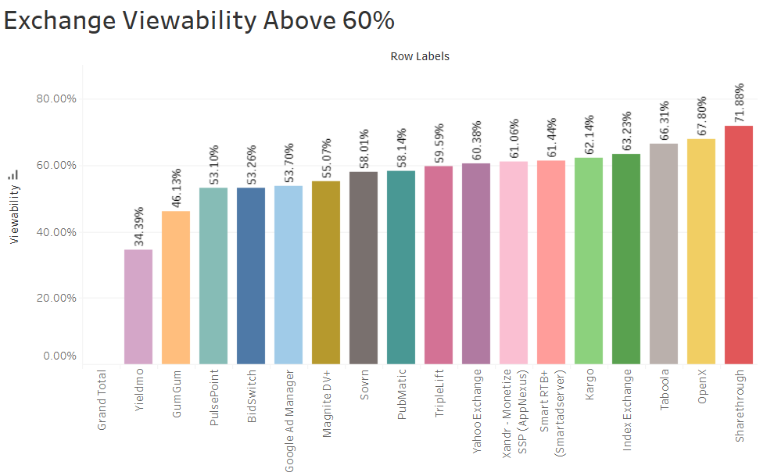
Secondary Goals Achieved
These are the exchanges that have above 60% viewability on their advertisement.
Yahoo Exchange 60.38%
Xandr - Monetize SSP (AppNexus) 61.06 %
Smart RTB (Smartadserver) 61.44%
Kargo 62.4%
Index Exchange 63.23%
Taboola 66.31 %
OpenX 67.88%
Sharethrough 71.88%

Slide 31
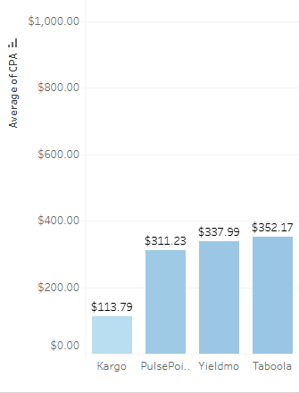
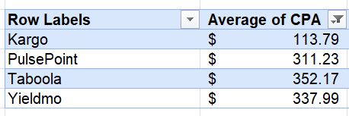
Exchanges:
Best CPA < $400

Slide 32
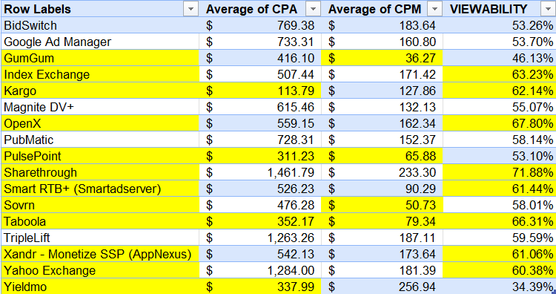



Exchanges that Achieved Goals
Primary Goals:
CPA < $400
CPM < $ 80
Secondary Goals:
Viewabilty > 60%
Taboola achieved CPA, CPM, and viewability.
PulsePoint achieved CPA and CPM
Kargo achieved CPA and Viewability

Slide 33

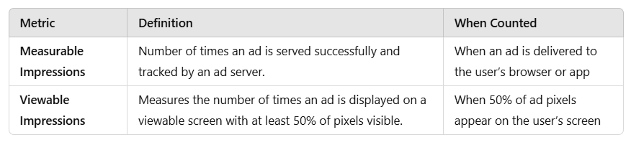
Impressions (measurable & Viewable)

Slide 34
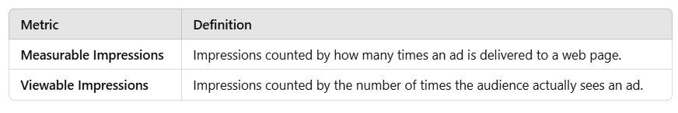
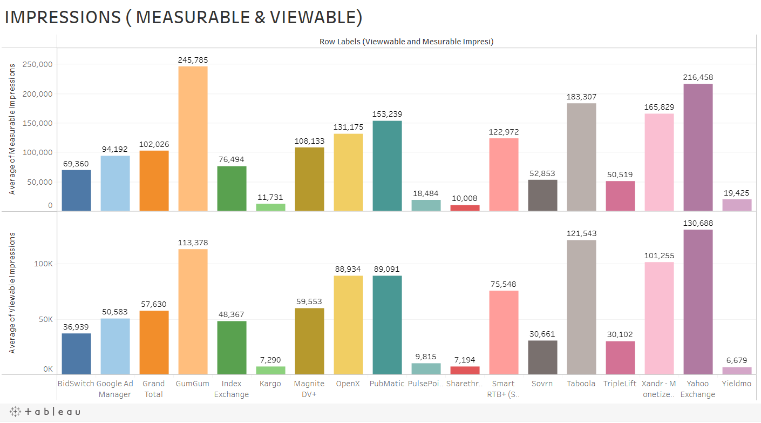

Slide 35

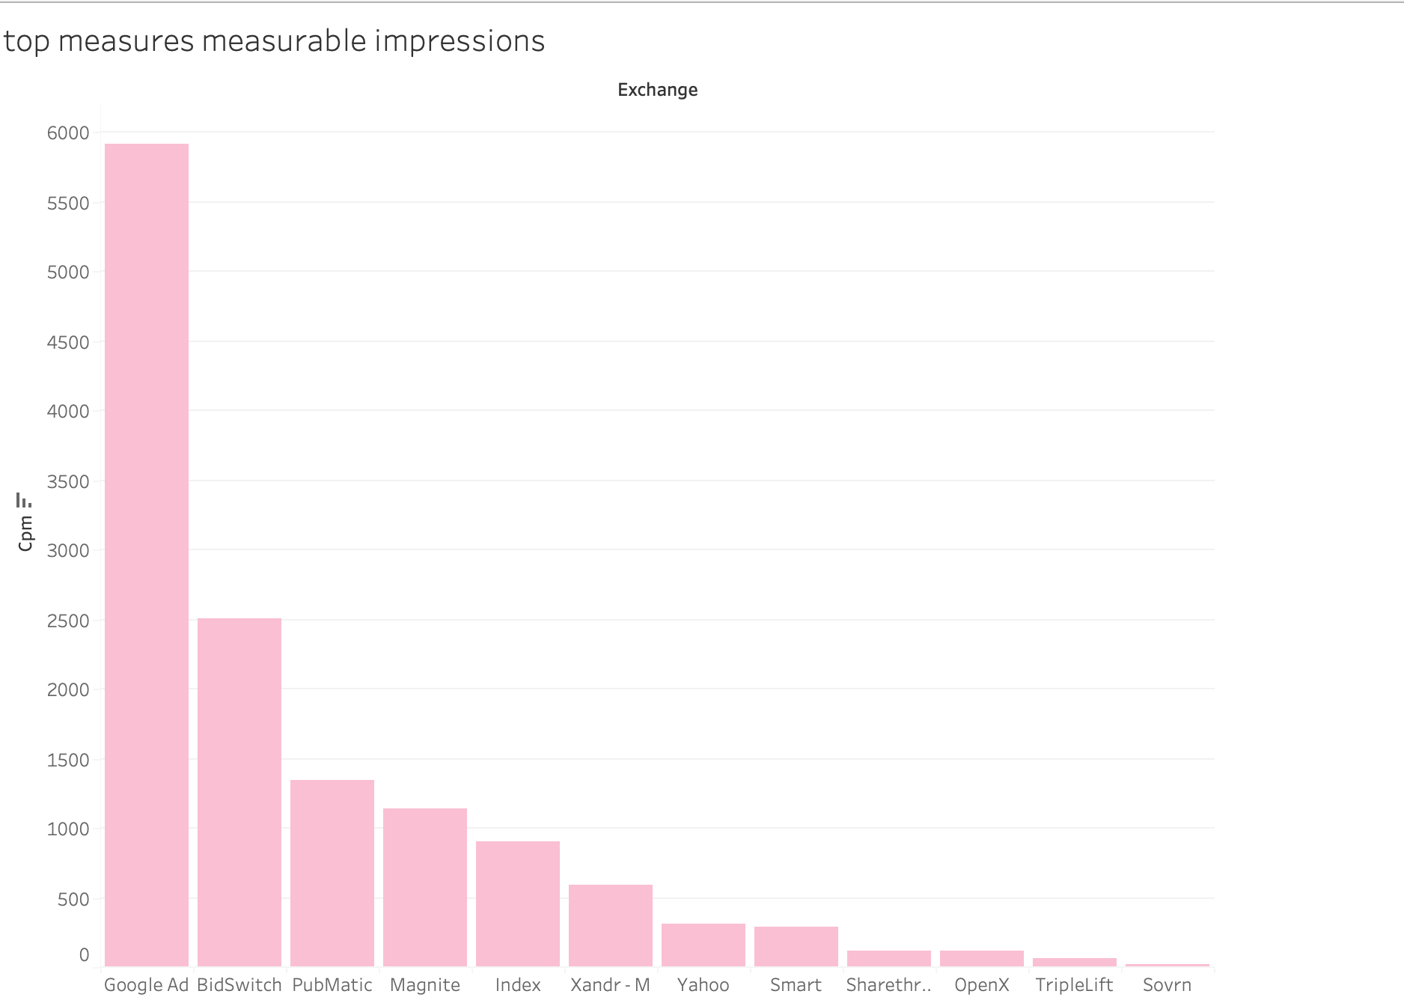


Top Exchange Performance: Viewable Impressions
Google Ads 5,909
Bidswitch 2,507
Pubmatic 1,343

Slide 36
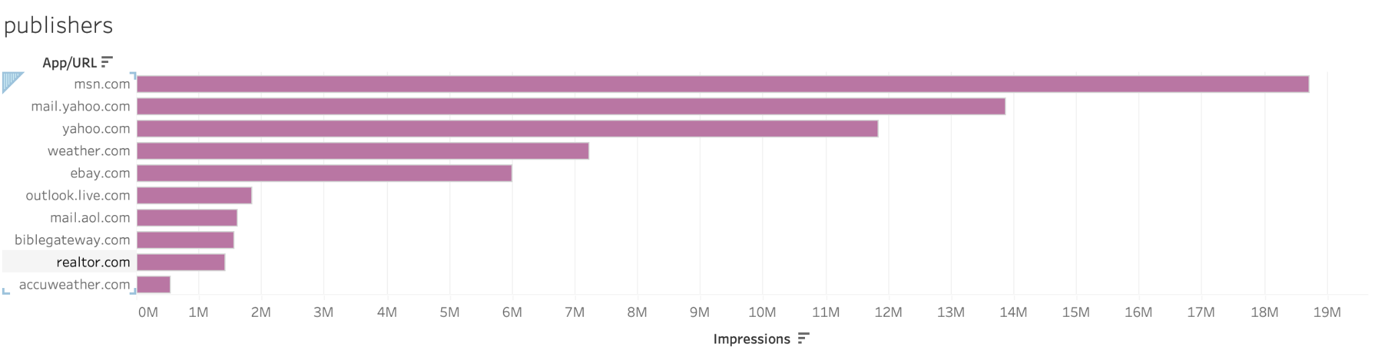



Top Ten Websites

Slide 37
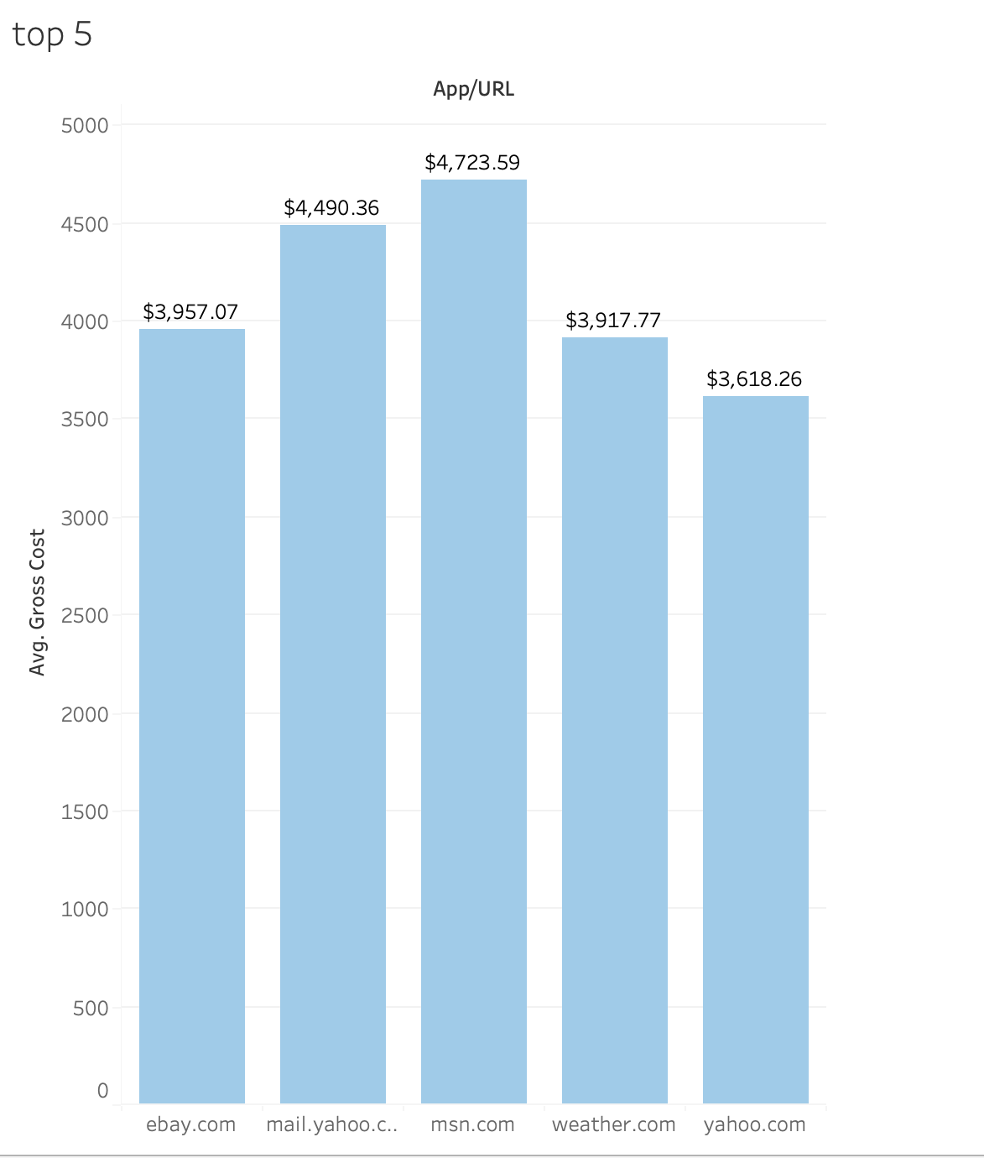


Direct Buy Rate Recommendations
1st. $4,723.59
2nd. $4,490.36
3rd.$3,957.07

Slide 38
Key Findings
Audience
Top 10 audience based off the average CPA: Insurance, winter holiday travel, Auto, Travel, News, streaming audio, Behavior, telecom and service providers, News, shopping
Location
States that meet the primary and secondary goals for smartphone devices were: Kentucky, Ohio, Louisiana, and Arkansas.
The states that meet the primary and secondary goals for desktop devices were: South Carolina, Georgia, and Alabama.
Top three states that were most cost effective when looking at Cost Per Acquisition (CPA) were: Kentucky, Ohio, and Arkansas.
Notes:
Read our parts

Slide 39
Key Findings
Creative
Best for Mobile 300 x 250 and although more expensive to run the 320 x 50 on desktop provides decent performance overall
Ohio, Illinois and California offer great performance metrics for mobile ad campaigns
“Sign up now/today” ad messages offer reliable performance for mobile banner and desktop formats.
Inventory
Out of 17 exchanges, 4 met the primary goal of a CPA below $80, while 8 met the secondary goal of an exchange viewability above 60%. Exchanges that Achieve both goals: Taboola achieved CPA, CPM, and viewability; PulsePoint achieved CPA and CPM; and Kargo achieved CPA and viewability.
The top three direct-buy websites are MSN, Yahoo Mail, and eBay, while the best exchanges for viewable impressions are Google Ads, Bidswitch, and Pubmatic.

Slide 40
Recommendations
Advertisement should focus on people who are interested in traveling, finance, and tech-savvy individuals
Ad formats should be used on their optimized device platforms
Mobile ads offer a great bang for your buck as they are cheaper to run and results in great overall performance.
Running less Mobile Banners on mobile and instead running more Mobile Leaderboards ads or even spending a bit of cash and running more Mobile Rectangle desktop ads
By assessing publishers and exchanges, we identified the most efficient platforms for ad placements based on impressions and gross cost, creating a clear, strategic path to boost engagement, increase conversions, and drive overall campaign success.
In terms of location strategy, it is clear we need to allocate our advertising budget more evenly across states. We should also invest more into states like Ohio, and Kentucky since they were the most cost effective states in terms of Cost Per Acquisition (CPA)

Slide 41


"Marketing with Ad-Venture Time isn’t just about data; it’s a treasure hunt where each insight reveals a new path to connecting with your audience."
→ ChatGPT

Slide 42


